Slide 1
CHURN MODELLING USING CNN
Presented by:
SRIBALA R
III year ,AI & DS
COLLEGE-KVCET
NM ID-au421221243039
Email ID- ravibala9842@gmail.com

Slide 2
PROPOSED SYSTEM
The project propose a novel churn prediction model using Convolutional Neural Networks (CNNs).Customer churn is a significant concern for businesses. Predicting churn allows for proactive measures to retain valuable customers : Defining churn prediction as a binary classification problem where the goal is to predict whether a customer will churn or not based on historical data.

Slide 3
PROBLEM STATEMENT
Develop a robust churn prediction model to identify customers at high risk of cancelling their subscriptions or services. This will enable businesses to proactively implement customer retention strategies and minimize revenue loss. This project will help businesses proactively target these at-risk customers with retention campaigns, ultimately reducing churn and increasing customer lifetime value.

Slide 4
PROPOSED SOLUTION
Develop a CNN model to analyze sequential customer behavior data and predict churn probability.
Why CNNs?
Can effectively capture temporal dependencies in sequential data (e.g., purchase history, website visits)
Automatically learn relevant features from data without manual engineering

Slide 5
SYSTEM APPROACH
Hardware
Processor: Intel Core i5 or equivalent (recommended)
RAM: 8 GB or more (recommended)
Storage: Sufficient space to store your data and software
Software
Python (programming language)
TensorFlow (machine learning library)
Keras (deep learning library)
NumPy (numerical computing library)
Pandas (data analysis library)
Matplotlib (plotting library)

Slide 6
ALGORITHM AND DEPLOYMENT
Algorithm Selection: Utilize Convolutional Neural Networks (CNNs) for their ability to automatically learn hierarchical representations from raw data such as images or sequential data like time-series.
Data Exploration: Analyze customer data including demographics, usage patterns, and transaction history to identify relevant features for churn prediction.
Problem Formulation: Define churn prediction as a binary classification problem where the goal is to predict whether a customer will churn or not based on historical data.
Deployment: Implement the CNN model using frameworks like TensorFlow or PyTorch, deploying it within scalable cloud infrastructure for real-time inference and integration into existing business processes."

Slide 7
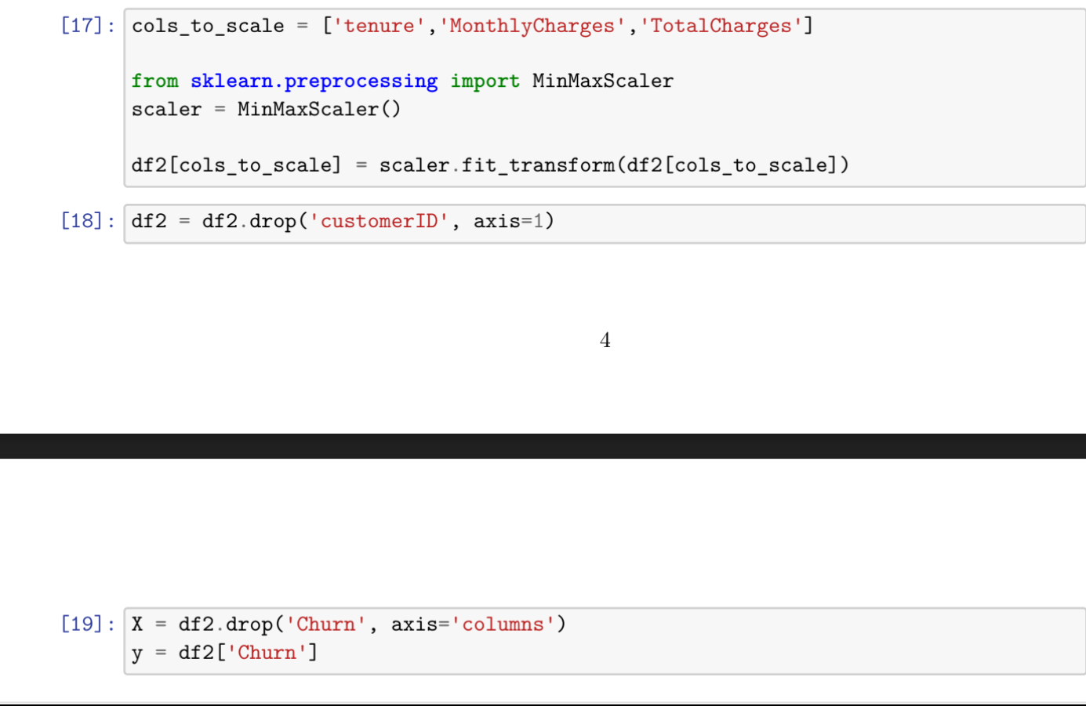
TRAINING AND PROCESS
Data splitting using train_test_split
Feature scaling using the MinMaxscaler
Model training using Convolutional Neural Network (CNN) which Utilize convolutional layers to extract spatial patterns from input data.
Incorporate pooling layers to reduce spatial dimensions and retain essential information.
Add fully connected layers for classification/regression.

Slide 8
PREDICTION PROCESS
New data input from Customer interaction data (e.g., usage patterns, complaints, inquiries),Historical churn records, Demographic information.
Preprocessing data using scaling ,encoding, normalization.
Performing the Model Inference on pre processed data
Interpret results to ultimately reducing churn and increasing customer lifetime values.
Output prediction results for further action

Slide 9
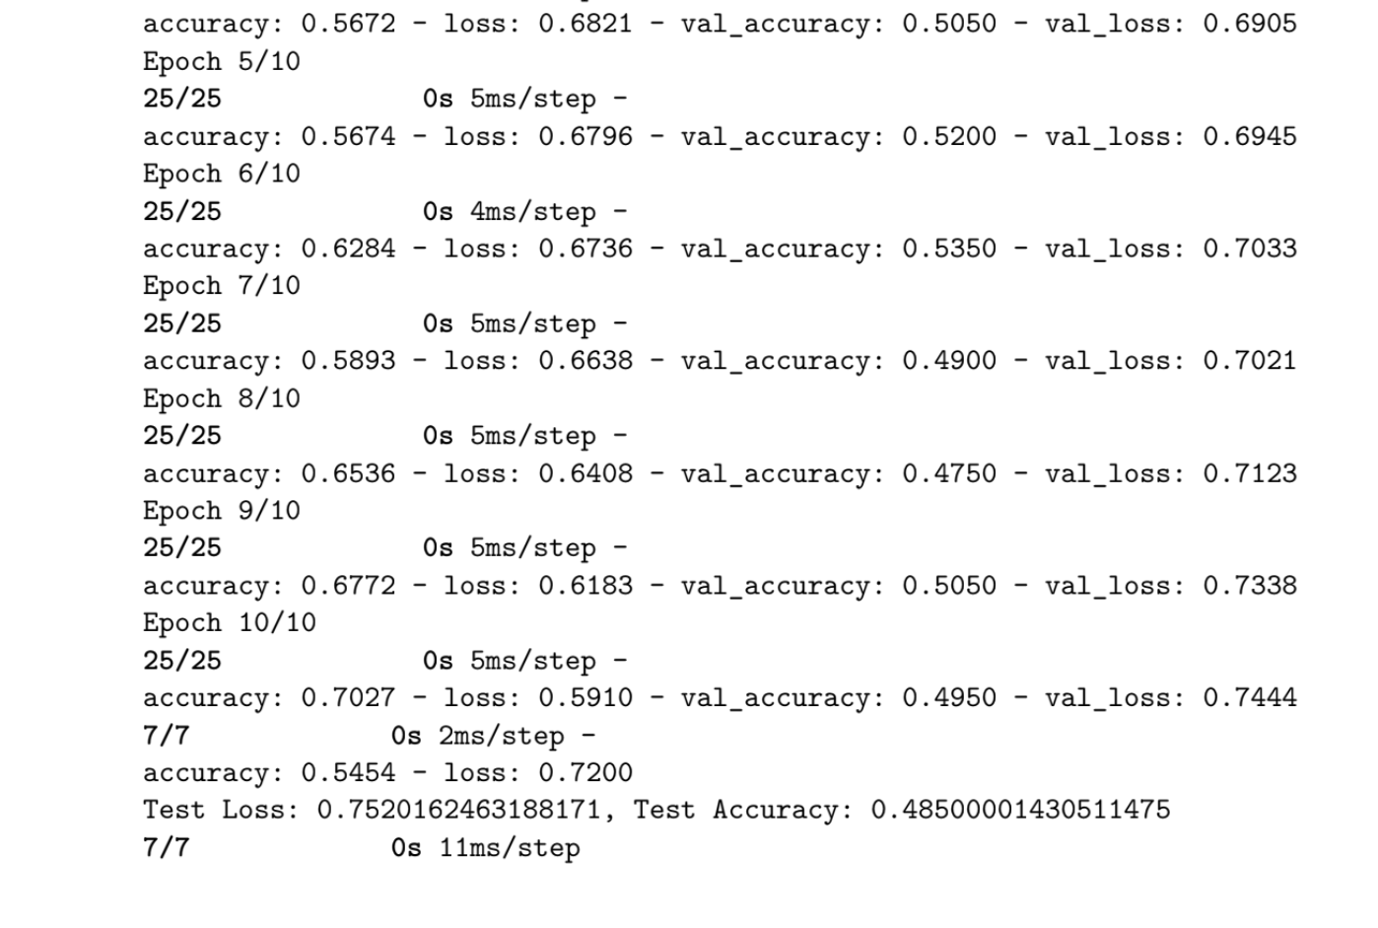
RESULT

Slide 10
CONCLUSION
In conclusion, CNNs offer a promising approach for churn prediction, providing businesses with a powerful tool to retain valuable customers.
CNNs are well-suited for churn prediction tasks due to their ability to handle complex, high-dimensional data .CNNs can automatically extract features from customer data, reducing the need for manual feature engineering.
By implementing a CNN-based churn prediction model, businesses can gain valuable insights into customer behavior and take proactive steps to reduce churn.

Slide 11
FUTURE SCOPES
Incorporating Multi-modal Data: Integration of diverse data sources such as text, images, and time-series data to capture richer customer behavior.
Personalization and Contextualization: Developing CNN architectures that adapt to individual customer preferences and contextual factors for more accurate churn predictions.
Real-time Churn Detection: Advancing CNN models for real-time monitoring and detection of potential churn events, enabling proactive intervention strategies.
Explainable AI Techniques: Enhancing interpretability of CNN-based churn models to provide actionable insights for businesses and improve decision-making processes.

Slide 12
REFERENCES
M. Park et al., 'Customer Churn Prediction in Telecommunication Industry Using Convolutional Neural Networks,' Expert Systems with Applications, 2020.
H. Chen et al., 'Enhancing Churn Prediction in Subscription-based Services Using Graph Convolutional Networks,' IEEE International Conference on Data Mining, 2023
M. Park et al., 'Customer Churn Prediction in Telecommunication Industry Using Convolutional Neural Networks,' Expert Systems with Applications, 2020.

